Slide 1
Micro-credentials linked to the Bologna Key Commitments
MICROBOL project
-
Magalie Soenen
-
1 February 2022

Slide 2
Details project:
Title: Micro-credentials linked to the Bologna Key Commitments
Erasmus+ KA3: Initiatives to support the implementation of European Higher Education Area (EHEA) reforms, 2019
Period: March 2020 – March 2022

Slide 3
Partners:
Belgium – Flemish Ministry of Education and Training
Finland – Ministry of Education and Culture
Italy – CIMEA
EUA
ENQA
Experts: Anthony F. Camilleri, Frederik De Decker, Ann Katherine Isaacs, George Ubachs, Peter Van der Hijden

Slide 4
Aim project:
Raise awareness among national governments
Encourage and guide national governments to include micro-credentials on the policy agenda
Check whether existing Bologna tools are fit for micro-credentials and/or propose changes for adaptations on European level
Formulate recommendations
Create a European Framework for micro-credentials

Slide 5
Structure & timeline:
Desk research (April-Aug ’20)
Kick-off conference (Aug-Sept ’20)
Working groups (Sept ’20–May ’21)
Quality Assurance (Belgium – Flemish Community, Peter van der Hijden, Anthony Camilleri)
70 participants, 34 countries, 7 stakeholder organisations
Recognition (Italy, Frederik De Decker, Peter van der Hijden)
60 participants, 33 countries, 5 stakeholder organisations
Qualification Frameworks (Finland, George Ubachs, Ann Katherine Isaacs)
60 participants, 32 countries, 7 stakeholder organisations
Survey among EHEA countries (Okt ’20-Feb ’21)
Recommendations on QA, Recognition & QF&ECTS (May-June ’21)
European Framework for Micro-credentials (July’21-Feb‘22)
Final Conference (March ’22)

Slide 6
Working definition:
A micro-credential is a small volume of learning certified by a credential. In the EHEA context, it can be offered by higher education institutions or recognised by them using recognition procedures in line with the Lisbon Recognition Convention or recognition of prior learning, where applicable. A micro-credential is designed to provide the learner with specific knowledge, skills or competences that respond to societal, personal, cultural or labour market needs. Micro-credentials have explicitly defined learning outcomes at a QF-EHEA/NQF level, an indication of associated workload in ECTS credits, assessment methods and criteria, and are subject to quality assurance in line with the ESG.

Slide 7
MICROBOL survey:
Aim of the survey: gain a picture on the state-of-play on micro-credentials in different member states of the European Higher Education Area and encouraging national discussion
Target: members of the Bologna Follow Up Group as well as the nominated representatives in the MICROBOL working groups
Respondents: 35 countries participated in the survey

Slide 8
Section 1 Investigating the use of micro-credentials
Overview of micro-credentials offered or being developed
Regulation of micro-credentials at national level

Slide 9
Countries that offer or are developing micro-credentials
Offered: 21 countries
Being developed: 3 countries
Not offered/not being developed: 8 countries

Slide 10
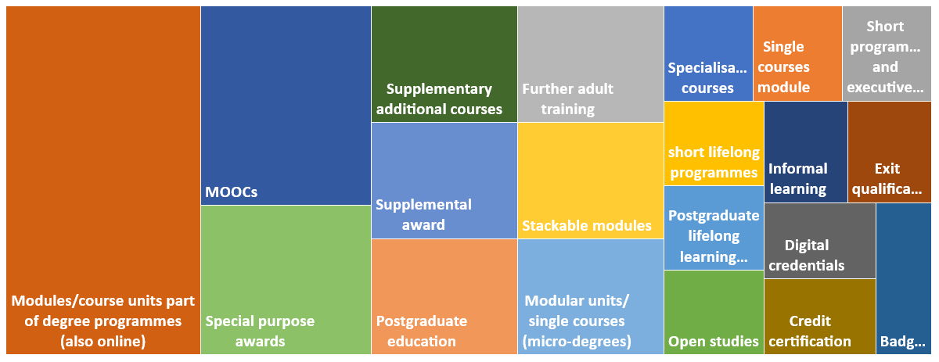
Examples of micro-credentials offered/recognised by HEIs

Slide 11
Official record or register of micro-credentials and providers
Notes:
The majority of the countries do not have a record/register of the micro-credentials offered, nor of the providers

Slide 12
Regulation of micro-credentials at national level
Regulated/allowed at national level: 22 countries
Specific regulations: 8
No specific regulations: 14
Under discussion: 6 countries
Institutions should not offer MCs: 1 country
Notes:
National legislation allows for the provision of micro-credentials in 22 countries out of 34. Among them, 8 reported that there are specific regulations concerning micro-credentials and 14 that there is no such national legislation.

Slide 13
Micro-credentials and digitalisation policies
NO policy on digitalisation:
21 countries
Yes policy but MCs are not part of it
7 countries
Yes MCs are part of this policy
5 countries

Slide 14
Section 2 Applying Bologna tools to micro-credentials
Quality Assurance
Recognition
Qualification Frameworks & ECTS

Slide 15
Micro-credentials included in the national QA

Slide 16
Sources of information on the QA status of the awarded credential

Slide 17
Purpose to recognise micro-credentials

Slide 18
Recognition of micro-credentials offered by non-HE providers
Only from HEIs: 18 countries
From HEIs and other providers: 16 countries
Notes:
Only from HEIs: lack of legislation, lack of QA or QA mechanism not in place yet, the only way is recognition of prior learning, microcredentials not yet developed, recognition only under certain conditions (for instance only adult education), it depends from the institutions. Dynamic picture

Slide 19
National framework open to micro-credentials
Open to MCs: 10 countries
At any level
5, 6 and 7
6
MCs awarded by HEIs can be referred to QF
Full degree referred to QF
Single module within a full degree (HEIs) can be referred to QF
Some examples of MCs referred to QF: 9 countries
Not yet: 15 countries

Slide 20
Micro-credential expressed in ECTS
MCs expressed in ECTS in some cases
2-4-6 ECTS
4-6 ECTS
Usually less than 10 ECTS
3-20 ECTS (module/single course within a full degree)
3-25 ECTS
20-50 ECTS
1-60 ECTS
Maximum 30 ECTS
Awarded by HEIs 13-30 ECTS (less frequently 0-6 ECTS. Continuing education 10 ECTS
MCs always expressed in ECTS
1 to 5 ECTS;
3 to 6 ECTS;
from 3 to 36 ECTS;
7.5 credits, 15 and 30 credits (for single courses within a full study programme in HE);
20-30 ECTS;
2-70 ECTS;
from less than 180 to less than 30 ECTS.

Slide 21
Stackability of micro-credentials
Learners can accumulate MCs: 17 countries
Most countries (8) recognise MCs in a full degree programme;
Learners cannot accumulate MCs: 16 countries
Not allowed by national legislation: 1 country

Slide 22
Type of support required
Notes:
In the field of quality assurance, support is required from 18 countries. 10 expressed also the type of support they would need

Slide 23
Section 3 Challenges regarding the application of Bologna tools to micro-credentials

Slide 24
Biggest challenges to apply Bologna Key Commitments to micro-credentials

Slide 25
MICROBOL recommendations:
Based on survey results & discussions in the working groups
Joint publication of 34 recommendations on QA, recognition & QF & ECTS
Target: EHEA countries and stakeholder organisations, but also European Commission -> Consultation
Download: https://microcredentials.eu/wp-content/uploads/sites/20/2021/07/MICROBOL-Recommendations-1.pdf

Slide 26
MICROBOL recommendations:
Transversal themes:
An opportunity to rethink higher education’s role in lifelong learning
Awareness of and common agreement on what a micro-credential is
A common format
Legislation
Digitalisation
Peer exchange and support, involvement of all actors, guidelines

Slide 27
MICROBOL recommendations:
Bologna Key Commitments:
Quality Assurance
Internal and external QA (e.g. All micro-credentials should be subject to internal QA, independently of the external QA approach)
Learner involvement in QA (e.g. Include learners in all steps of development and implementation of micro-credentials)
Transparency of information (e.g. HEIs should provide information on the quality assurance mechanism for awarded micro-credentials)
Register and catalogues of providers and micro-credentials (e.g. Ensure the inclusion of micro-credential providers in DEQAR)

Slide 28
MICROBOL recommendations:
Bologna Key Commitments:
Recognition
Coverage/link with Lisbon Recognition Convention (e.g. Make explicit to what extent micro-credentials can fall within the scope of the Lisbon Recognition Convention)
Recognition of prior learning (e.g. Use validation of learning outcomes from nonformal and informal learning only in cases where a formal (micro-)credential is absent)

Slide 29
MICROBOL recommendations:
Bologna Key Commitments:
Qualification Frameworks & ECTS
QF (e.g. The European discussion and national solutions
should be taken forward simultaneously, Micro-credentials should be included in the NQF, when possible)
ECTS (e.g. Ensure that the existing ECTS Users’ Guide (2015 edition) is well known and correctly followed by HEIs and its elements clarified for other stakeholders)

Slide 30
Final conference
Micro-credentials linked to the Bologna Key Commitments
Date: Tuesday 8 March 2022
Time: 13:00 – 17:00h CET
Place: online

Slide 31
For more information on the microbol project:
www.microcredentials.eu/
Or contact us:
microbolproject@gmail.com

